Slide 1
BrightTV
Viewership Analytics
Customer Value Management — Growth Strategy Presentation
Q1 2016 | Jan – Mar | 10,000 Sessions Analysed
CONFIDENTIAL • BrightTV CVM Team

Slide 2
Agenda
01
04
Executive Summary & KPIs
Factors Influencing Consumption
02
05
User Profiles & Demographics
Content Recommendations
03
06
Viewership Trends & Usage Patterns
Growth Initiatives

Slide 3
Executive Summary – Key Performance Indicators
9,738
4,211
5,375
Total Sessions (Q1 2016)
Unique Active Subscribers
Total Registered Users
1,487 h
9.2 min
21
Total Watch Time
Avg Session Duration
Channels Available

Slide 4
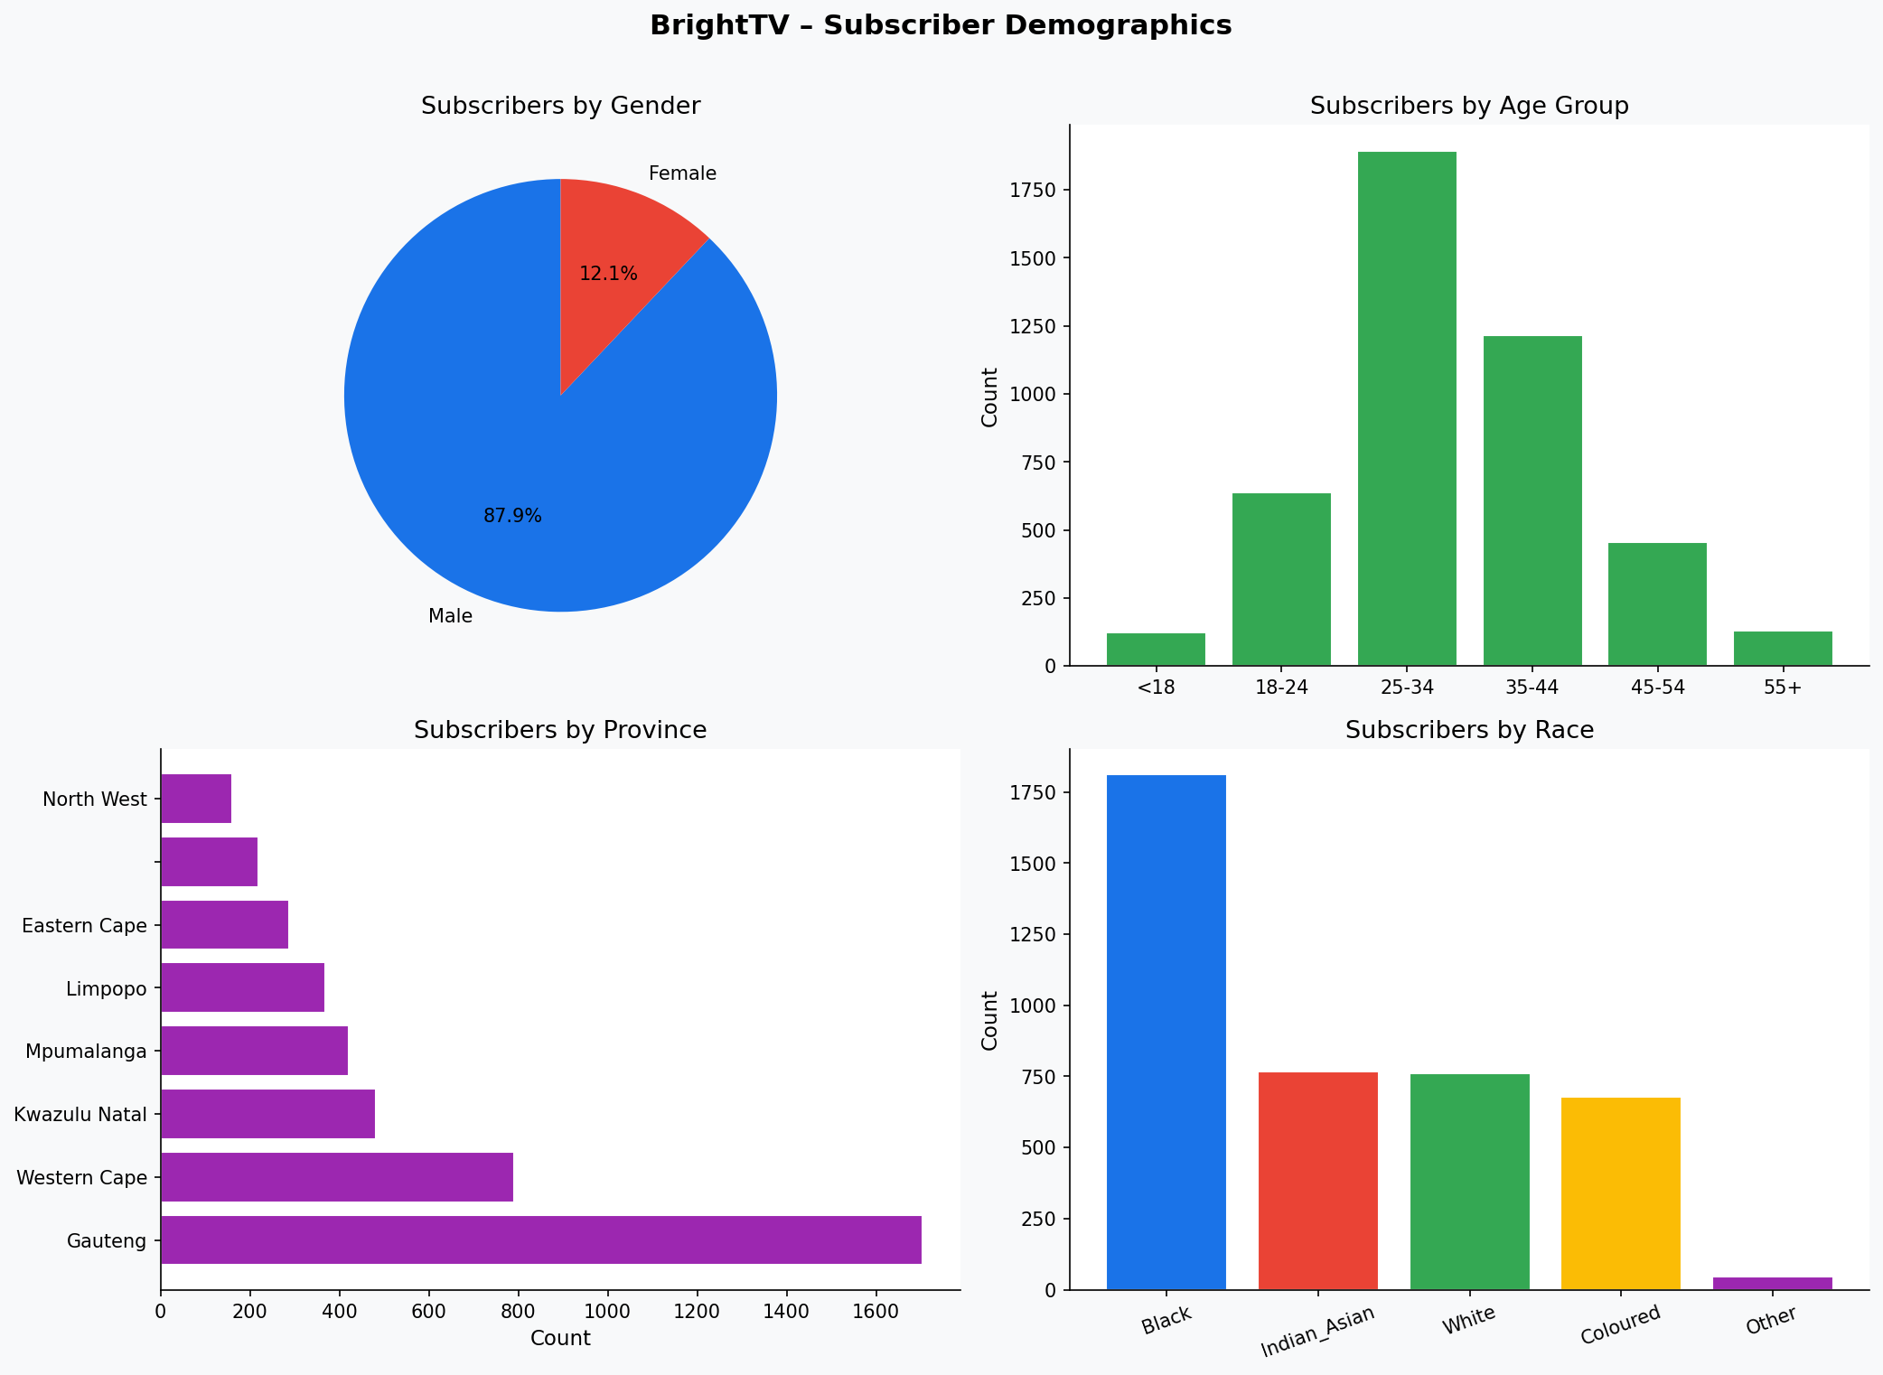
User Profiles & Demographics

Slide 5
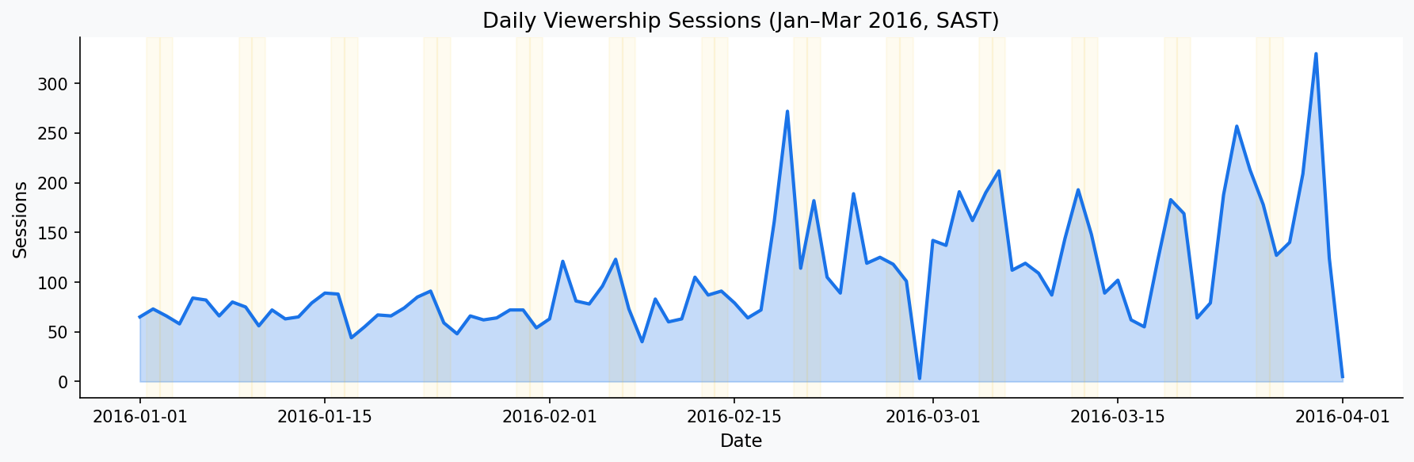
Viewership Trends – Daily Sessions (SAST)
Shaded bars indicate weekends. ICC Cricket World Cup 2011 matches drove spikes in March 2016.

Slide 6
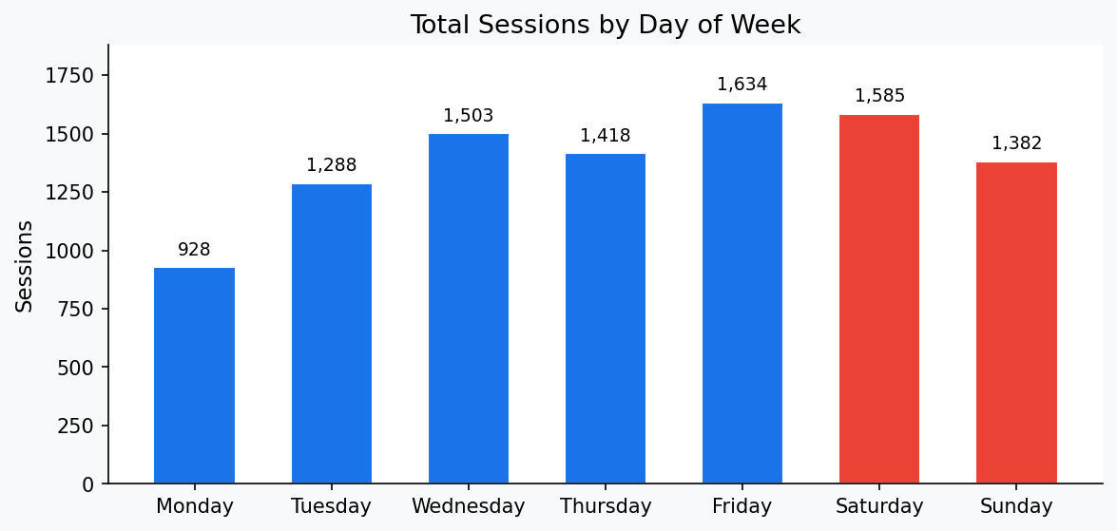
Viewership Trends – Sessions by Day of Week
Friday Peak
Friday generates the highest sessions (1,634), suggesting subscribers unwind after work/school.
Monday Slump
Monday is the lowest day (928 sessions) — nearly 43% fewer than Friday.
Weekend Steady
Weekends show moderate but consistent activity — a key engagement window.

Slide 7
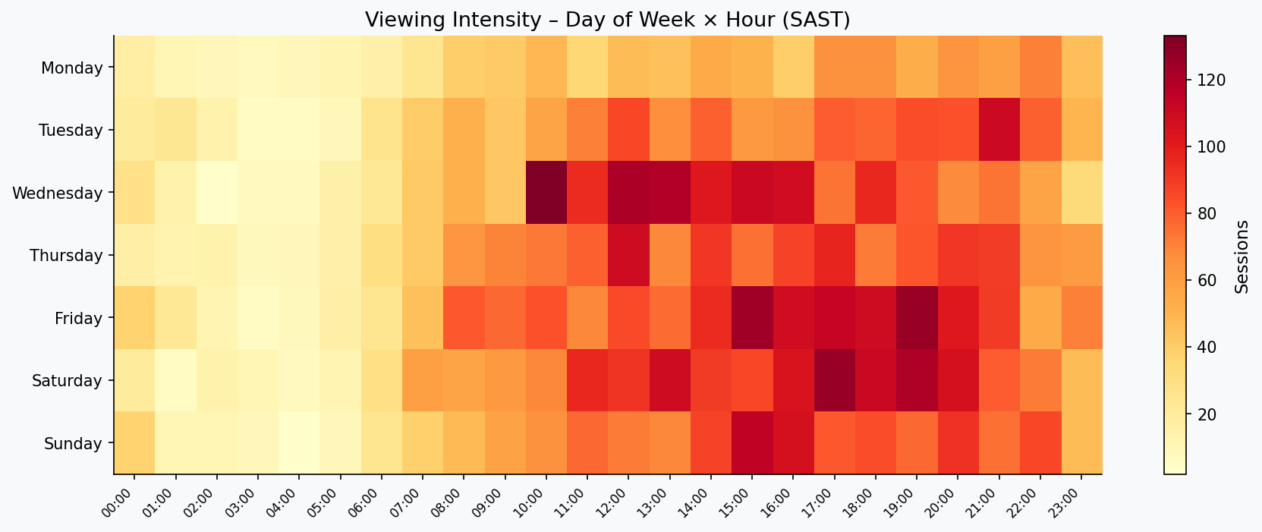
Viewing Intensity – Day × Hour Heatmap (SAST)
Peak viewing: 17:00–21:00 SAST across all days. Weekend mornings (09:00–12:00) also show elevated activity.

Slide 8
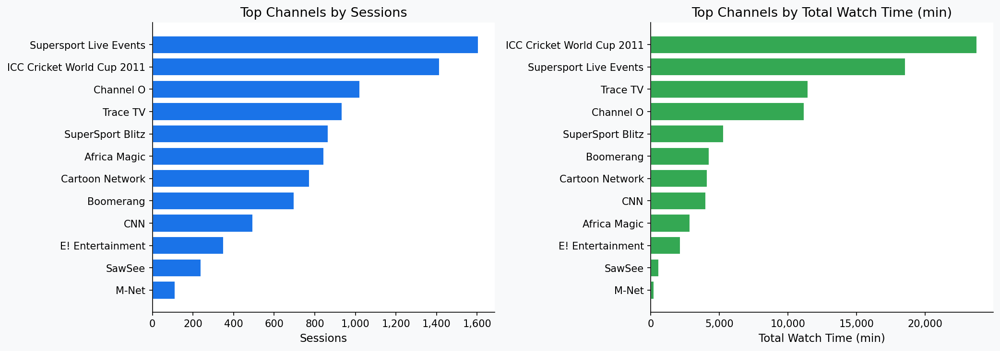
Top Channels by Sessions & Watch Time

Slide 9
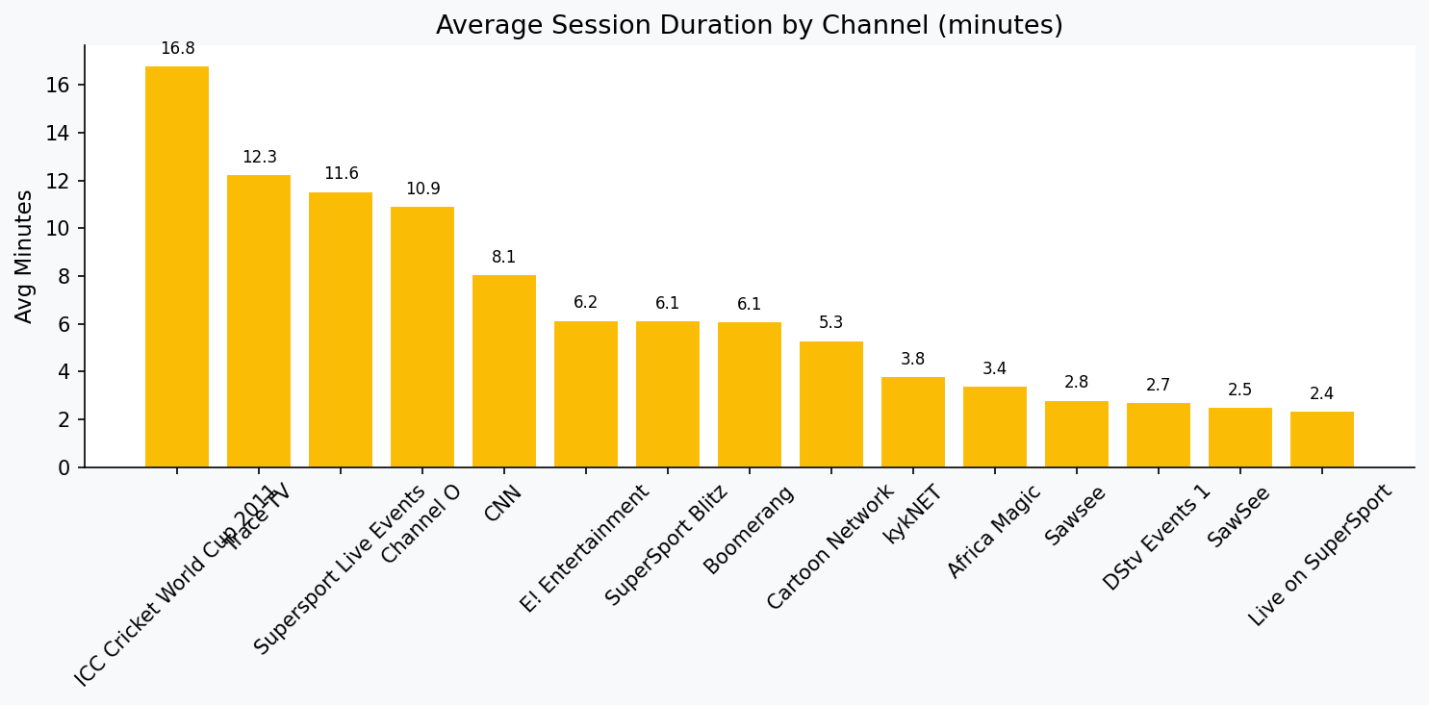
Average Session Duration by Channel
Channels with longer avg sessions indicate deeper engagement — useful for premium packaging decisions.

Slide 10
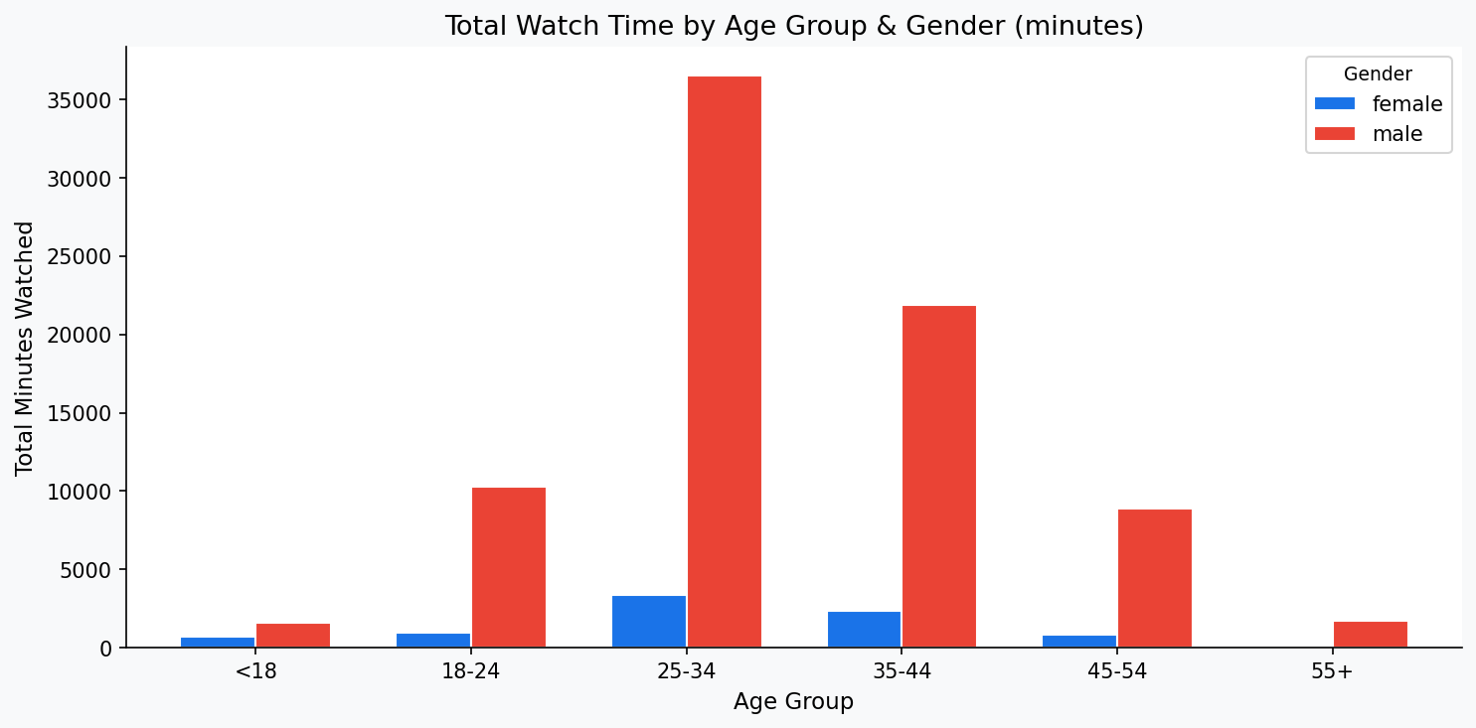
Factors Influencing Consumption – Age Group & Gender

Slide 11
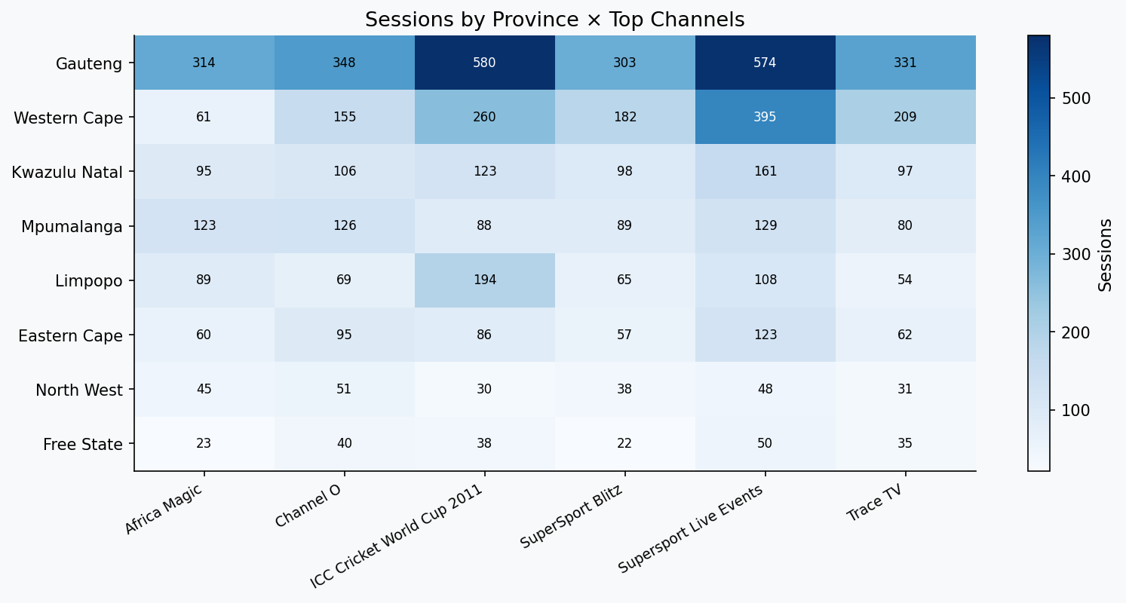
Factors Influencing Consumption – Geography & Channel Preference

Slide 12
Key Factors Influencing Consumption
Time of Day
Content Type
Evening prime time (17:00–21:00 SAST) drives the majority of sessions. Lunch hour (12:00–13:00) shows a secondary spike.
Sport (SuperSport Live Events, ICC Cricket) and music/entertainment (Channel O, Trace TV, Africa Magic) dominate watch time.
Demographics
Day of Week
Males aged 25–44 account for the highest consumption. Female engagement is significantly under-represented.
Friday is the clear peak day; Monday is the trough. Targeted promotions on low days could lift volumes by ~40%.
Geography
Event Seasons
Gauteng subscribers generate the highest activity. Rural provinces (Northern Cape, Free State) show untapped potential.
ICC Cricket World Cup viewership spikes confirm that live events are powerful consumption drivers.

Slide 13
Content Recommendations for Low-Consumption Days (Mon–Wed)
🏋 Fitness & Wellness — Monday Motivation
🎬 Binge-Ready Series — Series Drop Strategy
Workout series, yoga, health documentaries — align with the 'new week' mindset. Target 06:00–08:00 SAST morning slot.
Release new episodes of drama/sitcom series on Monday evenings to incentivise midweek logins.
🎮 Gaming & eSports — Youth Midweek Hook
📚 Education & Docu — Inform & Engage
eSports tournaments and gaming content attract the under-25 male segment during slow afternoon hours.
Documentary marathons and current affairs draw the 35–54 age group on Tuesday/Wednesday evenings.
🎵 Music Countdowns — Chart Shows
🌍 Local Content — SA Stories
Weekly Top-40 and Afrobeats countdowns on Channel O / Trace TV — low-production, high-appeal for under-30s.
Local South African content (reality shows, local drama) drives cultural connection and loyalty mid-week.

Slide 14
Growth Initiatives – Expanding the Subscriber Base
01 Female Subscriber Drive
02 Provincial Expansion (Rural SA)
Only ~10% of subscribers are female. Launch targeted campaigns via social media (Instagram/TikTok) featuring lifestyle, reality, and local drama content. Partner with female influencers.
Northern Cape, Free State and North West are under-indexed. Deploy affordable mobile-data bundles in partnership with MTN/Vodacom. Offer reduced-rate subscriptions for townships.
03 Youth Acquisition (Under-18)
04 Loyalty & Retention Programme
The under-18 segment shows low engagement. Launch a 'BrightTV Kids & Youth' tier with Cartoon Network, Boomerang and eSports. Offer student pricing and school holiday campaigns.
Reward long-session viewers with points redeemable for subscription discounts. A 'Streak Reward' (7-day consecutive login) can increase MAU and reduce churn.
05 Live Events & Sports Packaging
06 Social Sharing & Referral Engine
SuperSport & Cricket dominate consumption. Create sports season passes and live-event bundles to convert casual viewers into paid subscribers during peak sports seasons.
Leverage existing social media handles in the database. Build share-to-earn referral mechanics — reward subscribers for bringing in friends via their linked handles.

Slide 15
Key Takeaways
1
Friday evenings are peak — protect and enhance this window with premium content
2
Sport & Music are the two content pillars driving the most engagement
3
Female and rural subscribers are the largest untapped growth segments
4
Monday–Wednesday need dedicated content strategies to lift low-day sessions
5
Live events (cricket, football) are powerful subscriber acquisition tools
6
A referral + loyalty programme can accelerate organic subscriber growth
Thank you • BrightTV CVM Analytics • 2016

